Slide 1
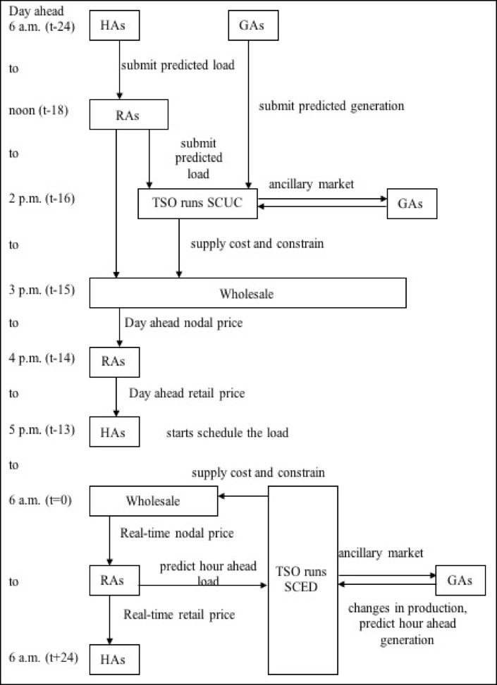
The conceptual research framework of this study is shown in this figure. There are consisted of keys method which are
Unit commitment
Economic dispatch
Nodal price calculation (LMP)
Forecasting in demand and generation

Slide 2
This progressive exam will show result on running economic dispatch to investigate locational marginal price (or called “LMP”) and LMP sensitivity due to load variation from (-20% to +20%)
The assumption of this result are forecasted load and genaration.

Slide 3
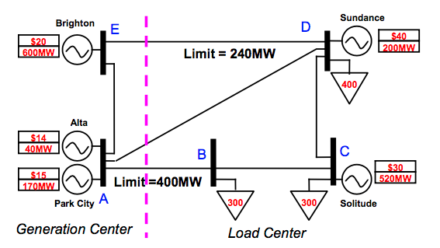
PJM 5 bus system

Slide 4
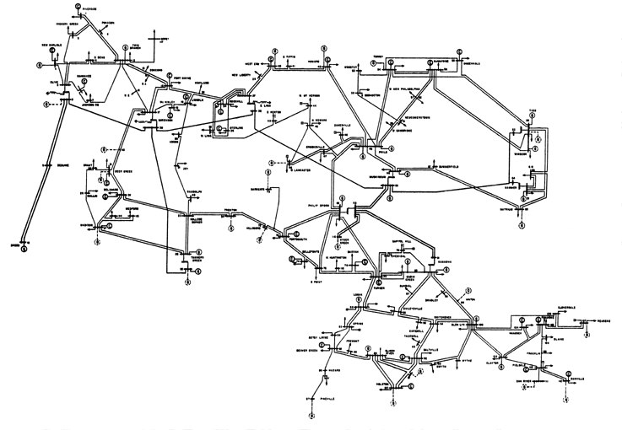
IEEE 118 bus test system

Slide 5
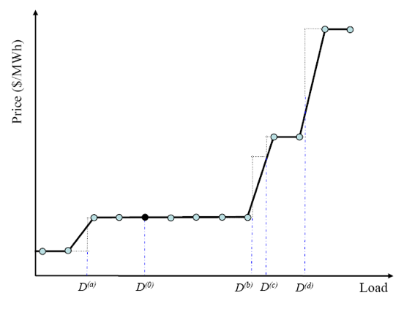
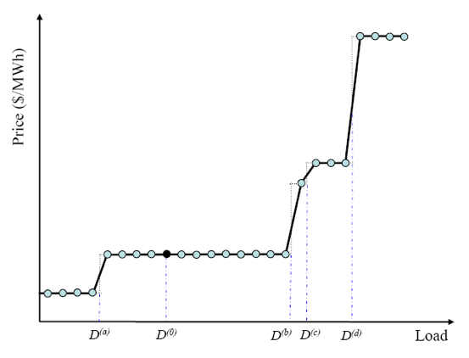




Low sample of LMP calculation
High sample of LMP calculation
$${LMP}_{D_{(b)}}$$
$${LMP}_{D_{(b)}}$$
$${LMP}_{D_{(0)}}$$
$${LMP}_{D_{(0)}}$$
High sample of LMP calculation give more accuracy but
comes with number of iteration and time consumption

Slide 6


$${LMP}_{D_{(b)}}$$
$${LMP}_{D_{(0)}}$$
The LMP calculation when load changed is call LMP sensitivity
due to load variation. It can be observed that when there is narrow
change in load, LMP remain the same

Slide 7
These highlighted boxes show that these iterations can be
eliminated due to very small change of LMP
(0.01$ or 1 cents per MWhr for this study)

Slide 8
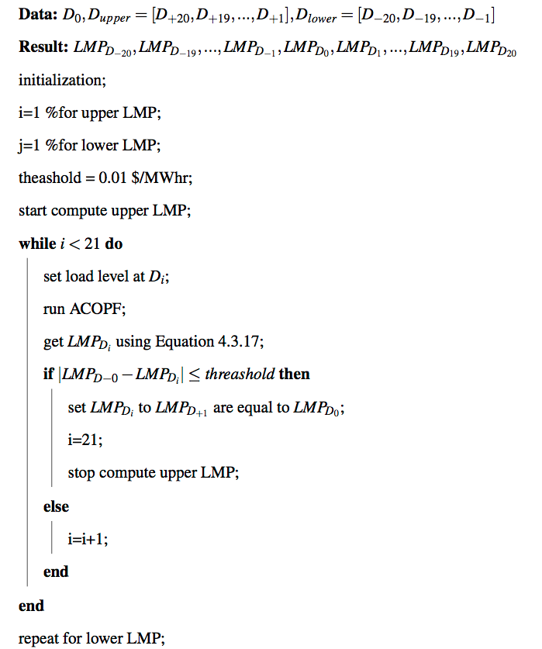

Slide 9
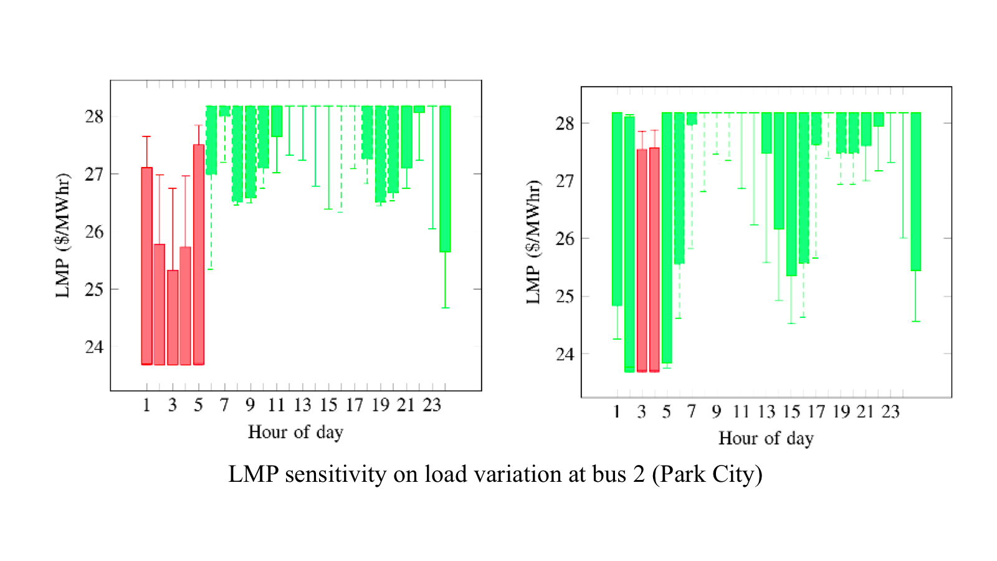
LMP sensitivity on load variation at bus B

Slide 10
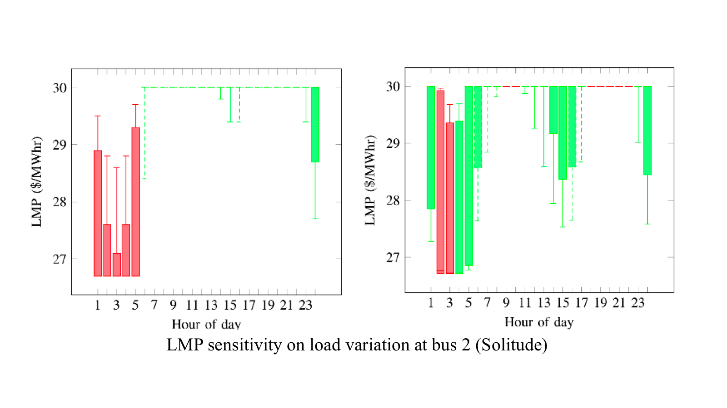
LMP sensitivity on load variation at bus C

Slide 11
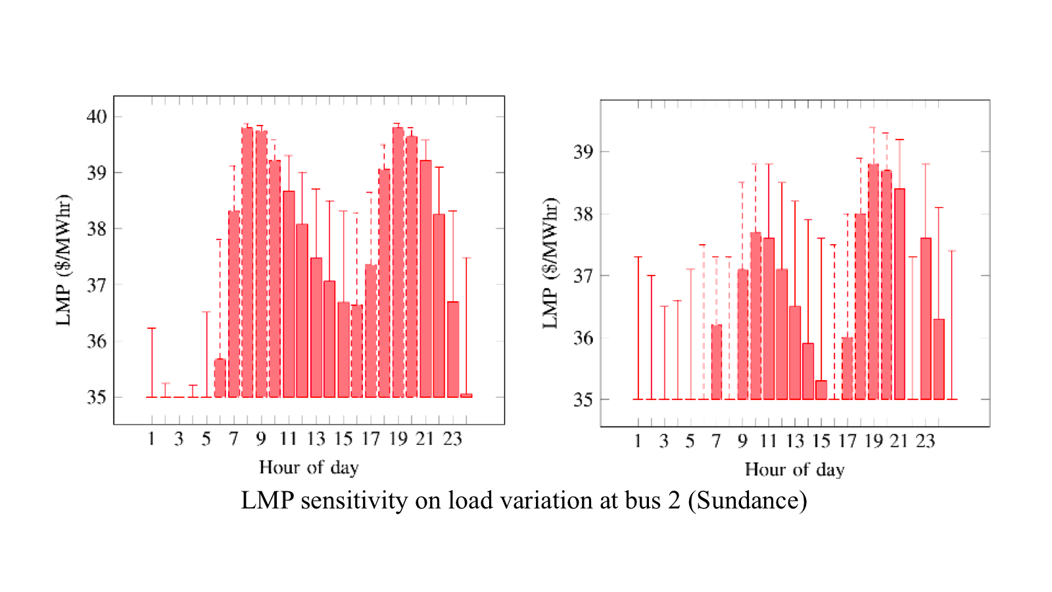
LMP sensitivity on load variation at bus D

